Slide 1
6th Comptroller Squadron
Hurricane Evacuation
Travel Entitlements Version: April 2024
Contact Information:
Finance.services@us.af.mil
(813)828-5377

Slide 2
Overview
Evacuation Timeline
Authorized Entitlements

Slide 3
Timeline
HURCON 5
(96hrs out)
HURCON 4 (72hrs out)
HURCON 3
(48hrs out)
HURCON 2
(24hrs out)
HURCON 1
(12hrs out)
RECOVERY
- Safe House / Haven locations id’d
- Members ensure GTC is available for use
- Certification roster created and signed by Unit CC
- Units ID members require EFT advances
- Validate personal/family evacuation plans
- CPTS mass activates GTCs
- LEO order issued / evacuation begins
- Installation shutdown
- Members and families remain at safe location
- Termination of evacuation order
- Members and families return to base

Slide 4
Evacuation Preparation
Members will update AFPAAS (or other accountability system)​
FSS/IPR will be briefing AFPAAS information
Safe House and Safe Haven locations should be identified
Distance from the installation could impact your travel entitlements depending on the Limited Evacuation Order (LEO)
Family members not in DEERS will not be eligible to receive government funded evacuation travel
Every military member must have a Government Travel Card (GTC)
This includes junior ranking and newly assigned personnel
Members who cannot posses a GTC must be identified to receive travel advances
HURCON 5
(96hrs out)

Slide 5
Evacuation Process
Authority to Order an Evacuation: 6 AMW/CC
Initially issues VOCO orders
Travel Entitlements begin
Limited Evacuation Order (LEO) published next
Establishes specific guidance for entitlements
Terminates/revokes LEO and issues return order
Entitlement termination based upon authorized travel time
HURCON 4 (72hrs out)
HURCON 3 (48hrs out)

Slide 6
Evacuation Process (cont.)
HURCON 4 (72hrs out)
Important considerations:
Only the 6 AMW/CC can authorize government funded evacuation allowances.
Mandatory City/County/State directed evacuations cannot authorize evacuation allowances
The LEO will specifically authorize who will / will not be eligible for evacuation allowances.
HURCON 3 (48hrs out)

Slide 7
Evacuation Process (cont.)
Important considerations:
Any evacuation that occurs outside of LEO
authorized days/radius will not be reimbursed.
The LEO will also establish evacuation zones/areas. If you do not reside in a location authorized by the LEO, you will not receive entitlements.
The LEO will also establish maximum evacuation travel distances.
HURCON 3
(48hrs out)
HURCON 2
(24hrs out)
HURCON 1
(12hrs out)
RECOVERY

Slide 8
Evacuation Process (cont.)
Evacuation Return:
Begins when the LEO/Evac order is terminated.
6 CPTS will conduct mass entitlements briefings and notify all units through PSAs.
Reimbursements will take time to process, expect several weeks until payout.
RECOVERY

Slide 9
Duty Status and Leave
Members supporting Hurricane COOP mission are not entitled to TDY allowances
Any leave in conjunction with evacuation must be managed at unit level
Safe Haven certification and leave status will be provided by each unit
Members on leave status will not receive allowances

Slide 10
Allowable Travel Time
Departure date based on LEO Authorization
The LEO may authorize different evacuation date/times for different evac zones
Return date based on LEO termination date and safe haven location:
1 travel day for every 350 miles for travel via private auto
Actual travel time for commercial air transportation

Slide 11
Entitlements
1. Lodging
Locality rate based off of location at 2400 hours
Limited to lesser of locality rate or actual expense
Lodging procured outside LEO authorized distance is limited to standard CONUS rate
No lodging reimbursement for staying with friends and family.
Receipts required. Lost receipt form will not be accepted.

Slide 12
Entitlements (cont.)
2. Meals and Incidentals (M&IE)
Rate based off of location at 2400 hours
Rate for locations outside of LEO authorized distance are limited to the standard CONUS rate
First and last day of travel are 75% of M&IE
Dependents per diem:
Age 12 and older receive 100% of locality rate
Age 11 and younger receive 50% of locality rate
Only for authorized dependents (DEERS)

Slide 13
Entitlements (cont.)
3. Mileage
Round trip mileage to “Safe Haven”
If “Safe Haven” is greater than LEO authorized max distance, reimbursement will be capped
$0.67 per mile
Multiple POV’s are authorized if licensed dependents are available to drive them

Slide 14
Entitlements (cont.)
4. Airfare
Actual expense for member/employee/authorized dependents if purchased from the CTO
Limited to constructed cost if personally procured
If Safe Haven location is greater than LEO authorized max distance, a constructed cost cap, determined by CPTS, will apply
Receipts required.

Slide 15
Non-Reimbursable Expenses
Common non-reimbursable expenses include:
Pet related expenses, rental cars, fuel, and clothing or purchase of baggage
Lost receipts forms
Certain expenses that occur outside of the LEO authorized evacuation distance
Expenses not authorized in the JTR

Slide 16
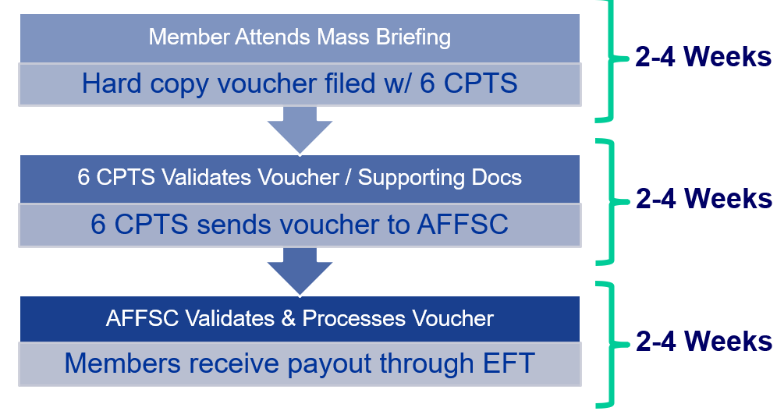
Travel Voucher Process
***Expect at least 60-90 days for payment processing

Slide 17
Important References
Defense Travel Management Office defensetravel.dod.mil
Per Diem Rates
Joint Travel Regulation (JTR)
Chapter 6 Evacuations

Slide 18
Recap
Topics covered: Evacuation Timeline, Duty Status and Authorized Entitlements
Every evacuation will be different
Members must qualify under the LEO to receive evacuation allowances
All allowances are based upon standard TDY rules
Any questions regarding entitlements can be directed to the 6th Comptroller Squadron

Slide 19
Recap
GTC is not authorized to protect or prepare homes or personal property
GTC charges cannot be incurred prior to evacuation order being issued.
Locality rates apply to designated evacuation areas within LEO travel limits
Receipts are required for lodging and any charges $75 or more
No lodging reimbursement for staying with friends and relatives
Departure and return day per diem is paid at 75%
NO entitlement for traveling prior to ordered evacuation

Slide 20
Questions?

